Slide 1
Computer Organization & Assembly Language (CSC-205)
Lecture 8

Slide 2
2.6. SEGMENT ASSOCIATION
Think of a Huge Building with Apartments
Imagine you live in a big apartment building. The building has many floors, and each floor has many rooms. Now, if I tell you "Go to Room 5," you might get confused. Why? Because every floor has a Room 5! You need to know which floor to go to first.
How Does This Relate to Memory?
Your computer’s memory works the same way! It has segments (floors) and offsets (rooms). When the computer wants to find a piece of data, it needs both the segment (which floor) and the offset (which room).
Notes:
Read page 25 from bilal hashmi notes

Slide 3
2.6. SEGMENT ASSOCIATION
How the Address is Found
The effective address is like the room number. But just knowing "Room 5" (offset) is not enough—you need to know which floor (segment) it belongs to.
The segment address tells you the floor.
To find the real physical location, the computer does some math:
Multiply the segment number by 16 (because each segment starts 16 bytes apart).
Add the offset (room number) to get the exact address.
Notes:
Read page 25 from bilal hashmi notes

Slide 4
2.6. SEGMENT ASSOCIATION
Example : Finding a Memory Address
Let’s say:
Segment (Floor) = 1000
Offset (Room) = 0A00
👉 First, multiply the segment by 16 → 1000 × 16 = 10000
👉 Then, add the offset → 10000 + 0A00 = 10A00
So, the real memory address is 10A00 (like saying "Go to Floor 1000, Room A00").
Notes:
Read page 25 from bilal hashmi notes

Slide 5
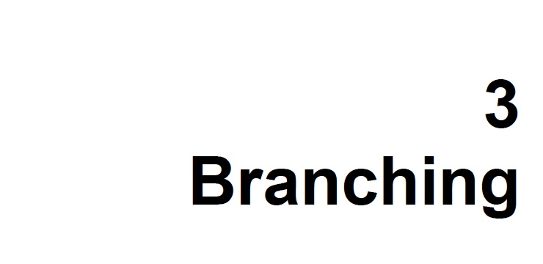

Slide 6
Example : Adding Two Numbers
section .data
num1 dw 5 ; First number (stored in memory)
num2 dw 10 ; Second number (stored in memory)
result dw 0 ; Variable to store result
section .text
mov ax, num1 ; Load first number into AX
add ax, num2 ; Add second number to AX
mov result, ax ; Store result back in memory

Slide 7
Example : Example with Segment and Offset:
mov bx, 0004h ; Offset value
mov ds, 1000h ; Segment value
mov ax, [ds:bx] ; Load value at segment 1000h, offset 0004h into AX
add ax, [ds:bx+2] ; Add value at segment 1000h, offset 0006h
mov [ds:bx+4], ax ; Store result at segment 1000h, offset 0008h

Slide 8
3.2. CONDITIONAL JUMPS
For every interesting or meaningful situation of flags, a conditional jump is there. For example JZ and JNZ check the zero flag.
If in a comparison both operands are same, the result of subtraction will be zero and the zero flag will be set. Thus JZ and JNZ can be used to test equality. That is why there are renamed versions JE and JNE read as jump if equal or jump if not equal.
JC and JNC test the carry flag. For example we may need to test whether there was an overflow in the last unsigned addition or subtraction.
Carry flag will also be set if two unsigned numbers are subtracted and the first is smaller than the second. Therefore the renamed versions JB, JNAE, and JNB, JAE are there standing for jump if below, jump if not above or equal, jump if not below, and jump if above or equal respectively. The operation of all jumps can be seen from the table in the next slide.

Slide 9
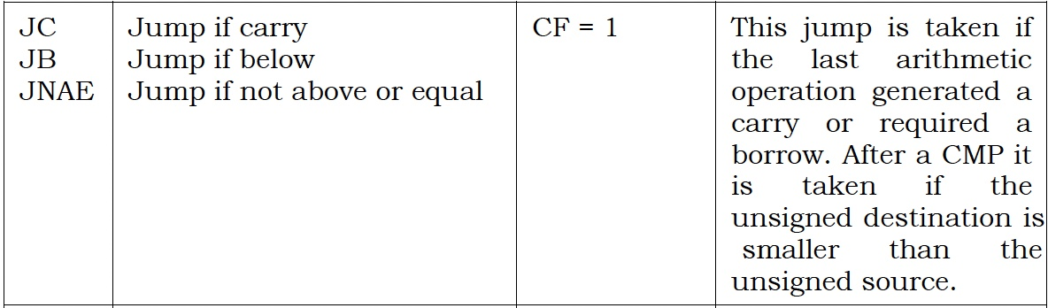
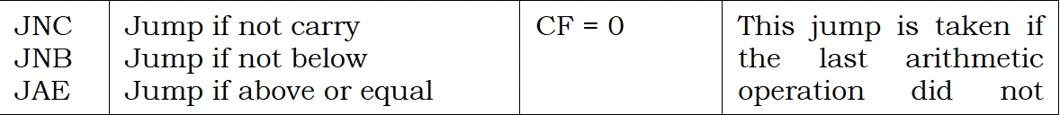
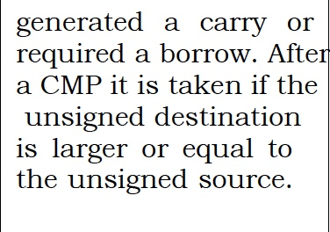
3.2. CONDITIONAL JUMPS

Slide 10
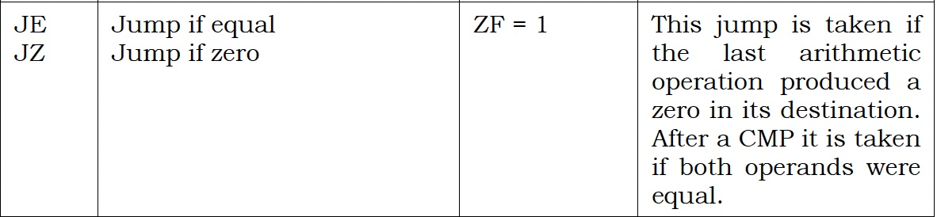
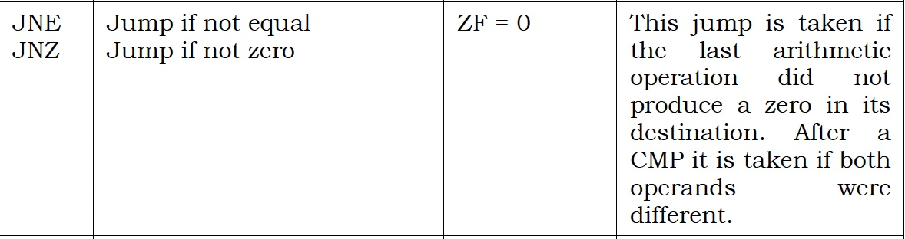
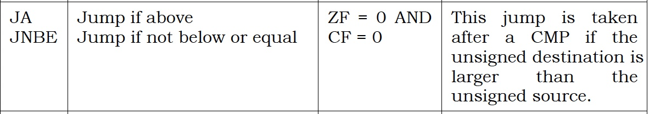
3.2. CONDITIONAL JUMPS

Slide 11
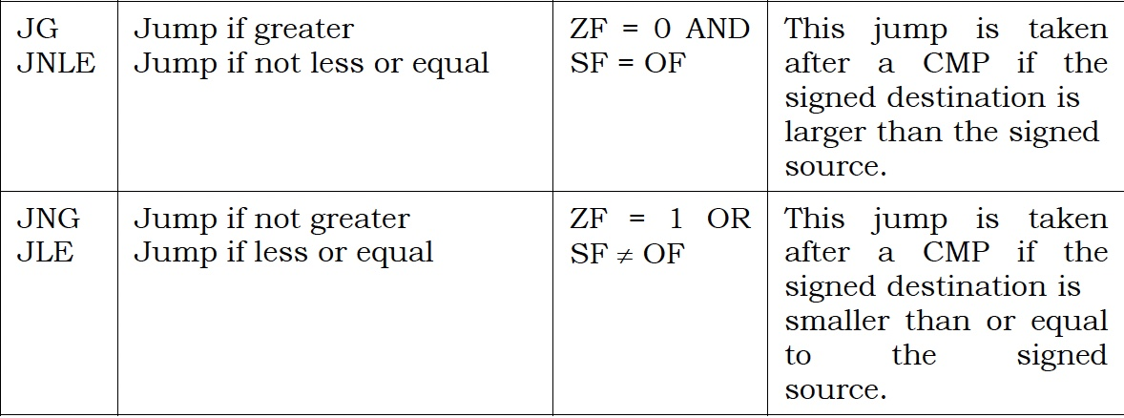
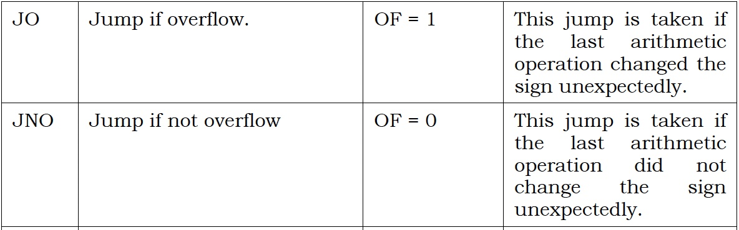
3.2. CONDITIONAL JUMPS

Slide 12
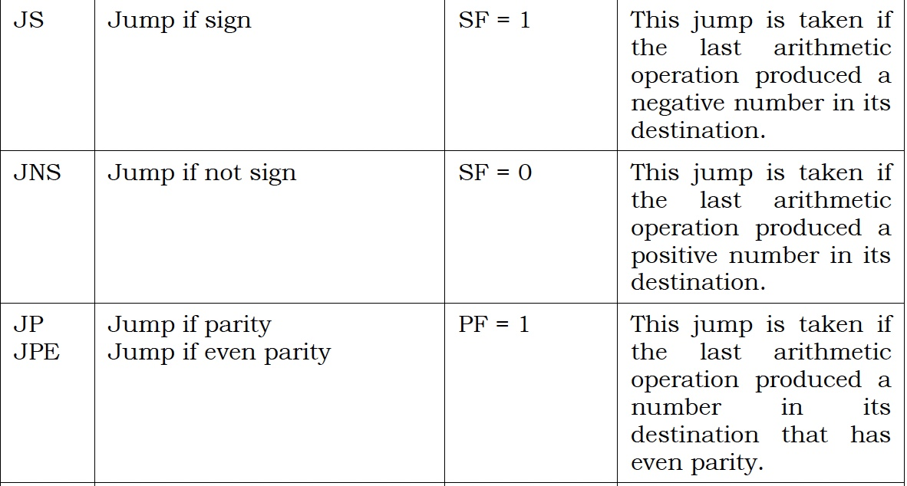
3.2. CONDITIONAL JUMPS

Slide 13
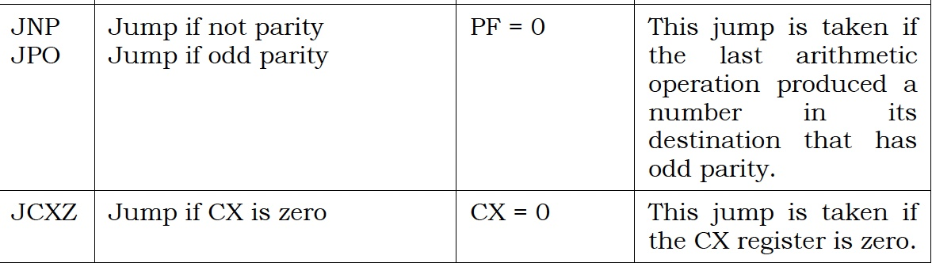
3.2. CONDITIONAL JUMPS

Slide 14
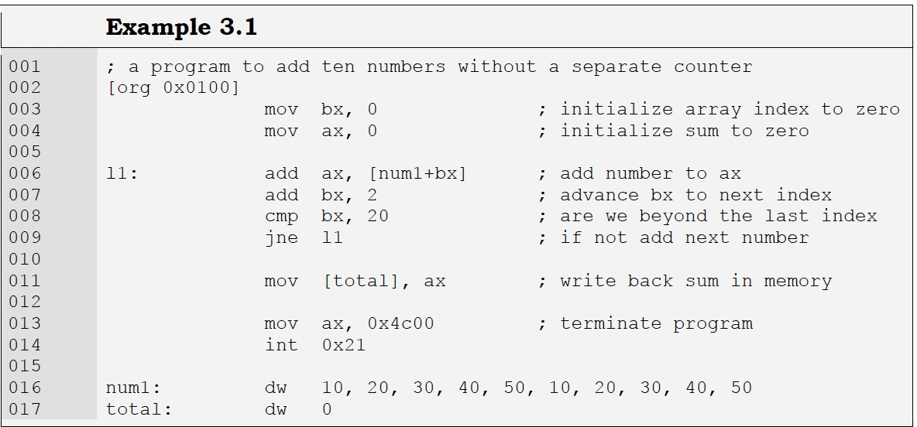
Example

Slide 15
3.3. UncONDITIONAL JUMPS
Till now we have been placing data at the end of code. There is no such restriction and we can define data anywhere in the code.
Taking the previous example, if we place data at the start of code instead of at the end and we load our program in the debugger. We can see our data placed at the start but the debugger is intending to start execution at our data. The COM file definition said that the first executable instruction is at offset 0100 but we have placed data there instead of code. So the debugger will try to interpret that data as code and showed whatever it could make up out of those opcodes.
We introduce a new instruction called JMP. It is the unconditional jump that executes regardless of the state of all flags. So we write an unconditional jump as the very first instruction of our program and jump to the next instruction that follows our data declarations. This time 0100 contains a valid first instruction of our program.

Slide 16
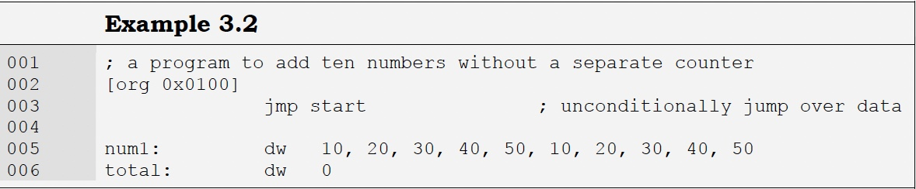
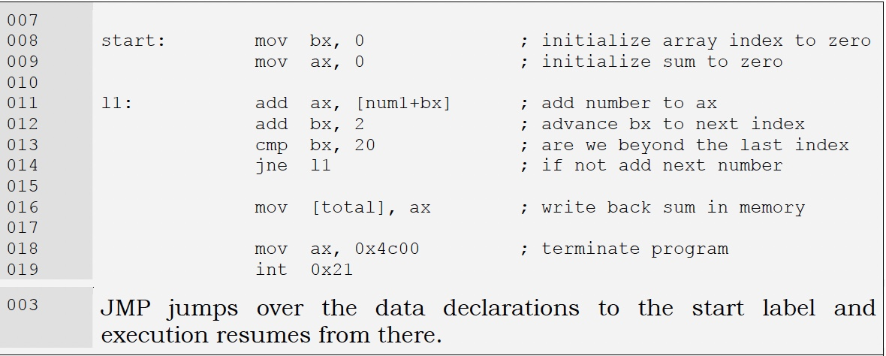
Example

Slide 17
End of Lecture

